Slide 1

PROJECT TWO
Waail Abdalla

Slide 2
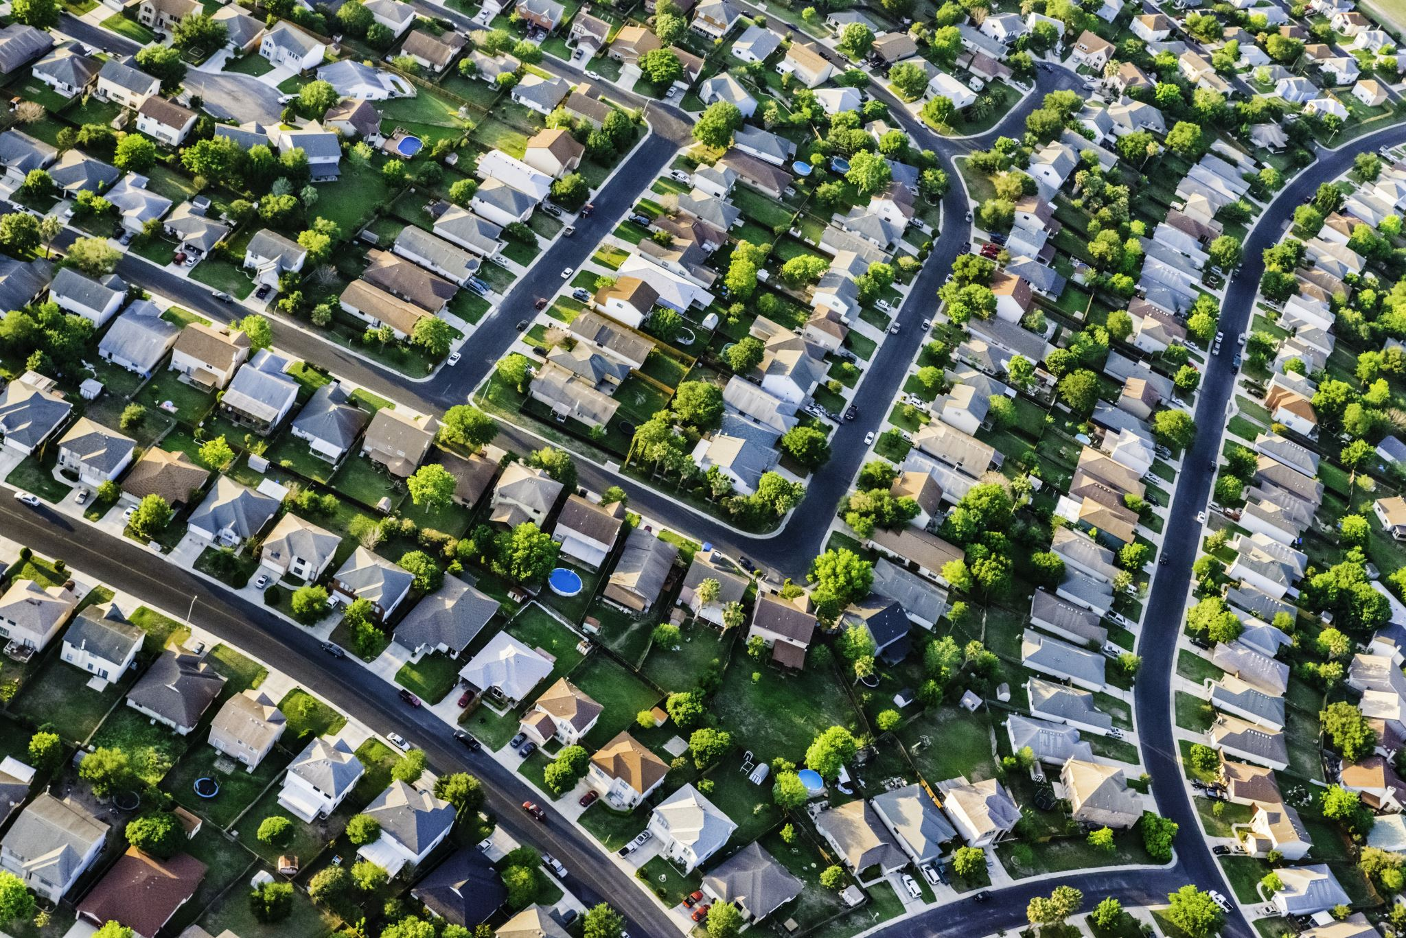
Business Problem
A residential builder based in the USA has had much success on the east coast. They are looking to expand their market into the west coast of the USA, starting in King County, Washington. The residential builder would like to understand what factors influence the price of a house in that area.
The aim is to generate designs of a house based on those 5 factors and offer it as an option in King County.
The model generated will be based on inference rather than prediction. I want to identify which features have a strong relationship with house price and see their effect.

Slide 3

Results
After 4 iterations, a collection of the top independent variables were used to create the final model. Using sklearn's feature selector the top 5 variables that have a strong relationship with the target variable price are:
grade_11
grade_12
bathrooms_3.75
view_3.0
view_4.0
I believe this linear regression model successfully solves the business problem of identifying the five factors that have a strong relationship with price. Initially I expected the adjusted R-squared of the model to increase as more statistically significant variables were identified. However, reducing variance and outliers proved to be the more important factor which result in a lower adjusted R-squared value.
Reducing the data set to within 2 standard variations initially looked extreme as the adjusted R-squared dipped to almost half of the baseline model. However when the first model validation was performed, it showed that the model was dramatically overfitting indicating a lot of variance was still present in the data set.
During each iteration, the P-values held true with the correlation heat map. This provides me with great confidence that the correct variables were being chosen to be used in the model. It is important for data to also make sense in a real world application. Looking at the top 5 variables, they are realistic in the sense that a typical person would expect those variables when evaluating the price of a house

Slide 4
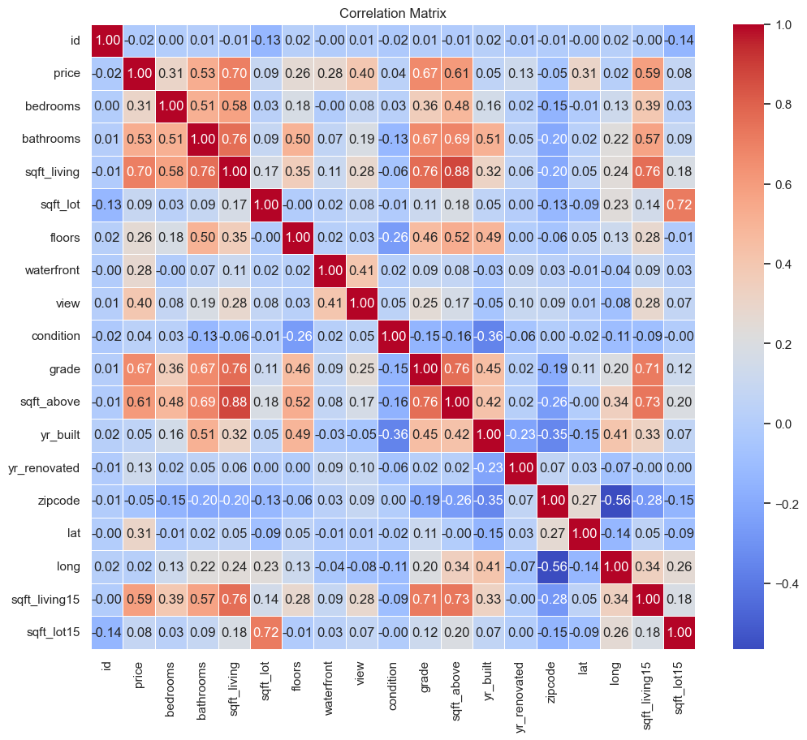

Slide 5
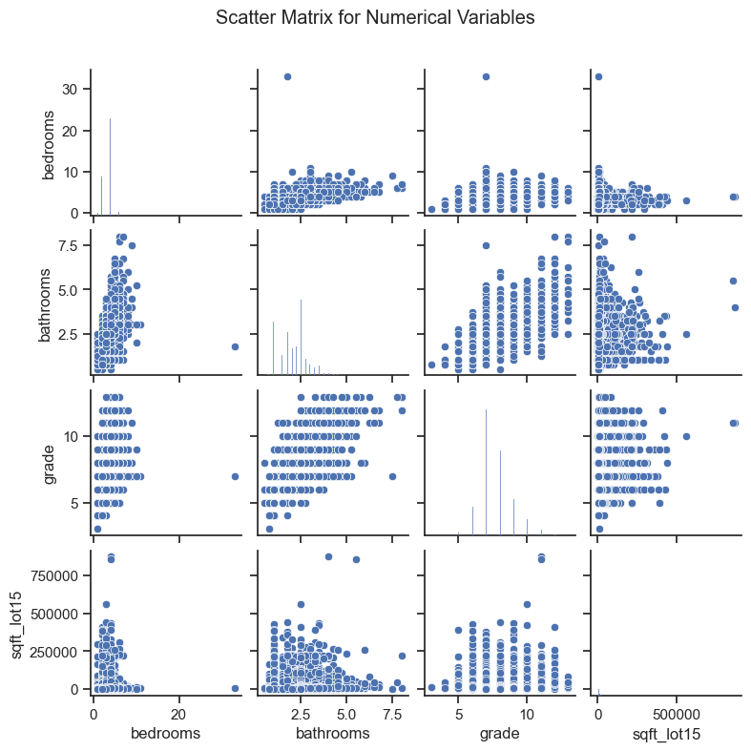

Slide 6
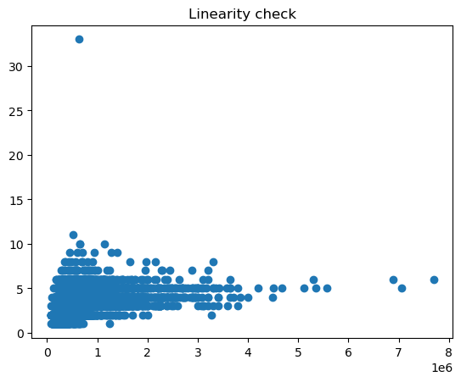

Slide 7

Conclusions
Conclusion
King County has a ranking system that represents the construction quality of improvements. They are generally defined as:
1-3 Falls short of minimum building standards. Normally cabin or inferior structure.
4 Generally older, low-quality construction. Does not meet code.
5 Low construction costs and workmanship. Small, simple design.

Slide 8
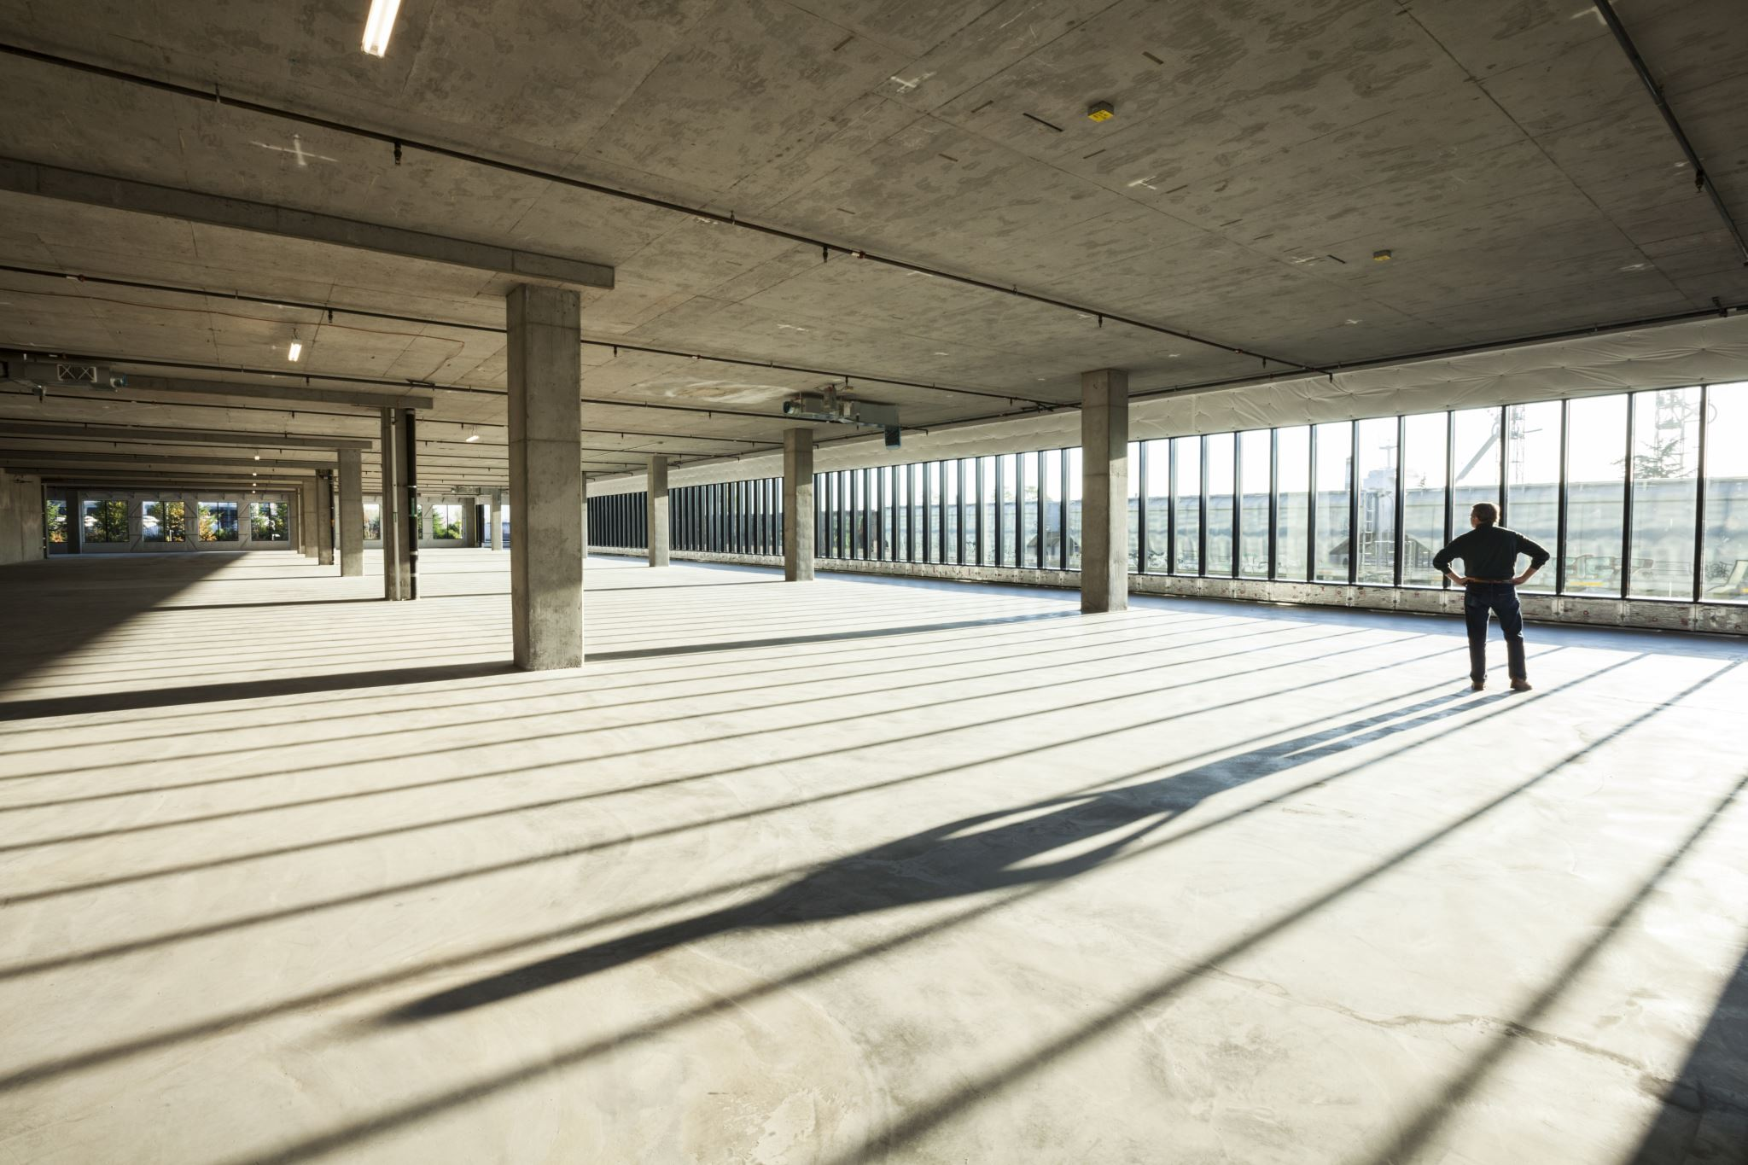
6 Lowest grade currently meeting building code. Low quality materials and simple designs.
7 Average grade of construction and design. Commonly seen in plats and older sub-divisions.
8 Just above average in construction and design. Usually, better materials in both the exterior and interior finish work.
9 Better architectural design with extra interior and exterior design and quality.
10 Homes of this quality generally have high quality features. Finish work is better, and more design quality is seen in the floor plans. Generally, have a larger square footage.

Slide 9
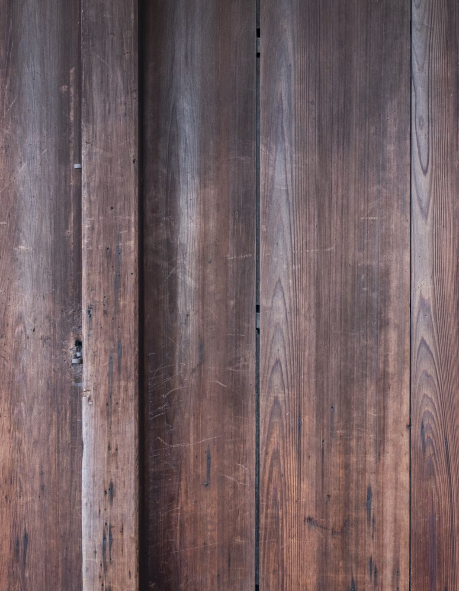
11 Custom design and higher quality finish work with added amenities of solid woods, bathroom fixtures and more luxurious options.
12 Custom design and excellent builders. All materials are of the highest quality and all conveniences are present.
13 Generally custom designed and built. Mansion level. Large amount of highest quality cabinet work, wood trim, marble, entry ways etc.
The results Grade 11 and 12 sit on the higher end of the ranking system and is reflective of the model that has been produced. Investing in an excellent builder, high quality materials and luxurious options will yield a higher house price.
Based on the statistical significance of the number of bathrooms throughout the iterations, it was observed that the number of bathrooms only started having a strong relationship with price at 3. Again this is reflective in the results at 3.75. The results suggest that many of the higher priced homes have a minimum 3 bathrooms.

Slide 10
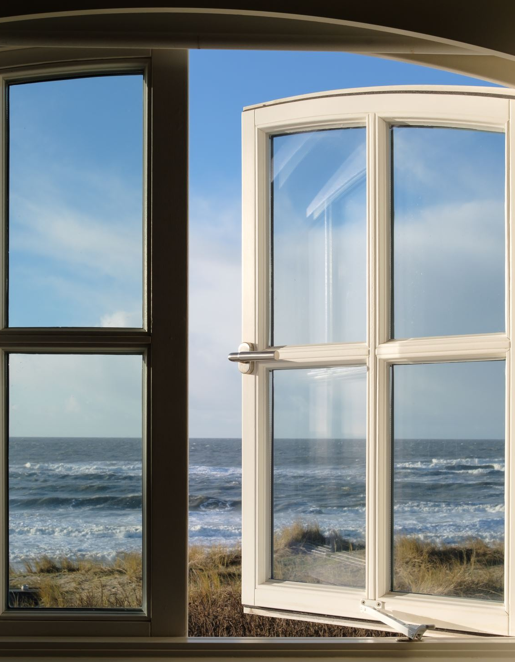
The features of the home are not the only important factors in raising the price of a house. The location is just as important and in this case, if the house has a view. King County has a variety of landmarks, ocean, lake and views. Opting to build a house within view of these natural and manmade points of interest and it will have a positive effect on the price.
In conclusion, in order for the east coast residential builder to be successful on the east coast, specifically King County, they must consider:
Creating a custom design using high quality materials, high quality finish work and luxurious options
Incorporating 3 or more bathrooms into their designs
Choosing a location of the house with a great view of local points of interest

Slide 11
Thank You!
Email: alwaliwaail@gmail.com
GitHub: @WaailAbdalla

